Slide 1

University Academic Management
Review-1
Batch – 13
S. Keerthi - 26B21CS076
T. Lakshmi Anvitha - 26B21CS079
G. Bhagya Deepthi - 25B11CS268
P. Roshitha – 25B11CS749

Slide 2

Introduction
University Academic Management is a system used to manage and organize academic activities in a university.
It helps in maintaining student, faculty, course, and examination details.
The system manages student enrollment, attendance, marks, grades, and academic records.
It helps faculty to update and manage student performance easily.
Students can access their courses, schedules, marks, and academic information.
It reduces manual paperwork and data errors.
It provides quick and easy access to academic information.
Overall, it makes university academic activities efficient, organized, and systematic.

Slide 3
Problem statement
Managing university academic information manually is time-consuming and difficult.
Student records, faculty details, courses, attendance, and marks may be stored in different places.
Manual record keeping can lead to data errors, duplication, and loss of information.
It is difficult to quickly search and update student academic records.
Faculty may face difficulty in managing attendance, marks, grades, and course details.
Students may not have easy access to their academic information.
Therefore, a University Academic Management System is needed to store, manage, and retrieve academic information in a simple, accurate, and organized way.

Slide 4
Objectives
To manage student academic records efficiently.
To maintain faculty, course, and department details.
To manage student attendance, marks, and grades.
To provide quick and easy access to academic information.
To reduce manual work, paperwork, and data errors.
To ensure accurate and organized storage of university data.
To make academic management simple, efficient, and user-friendly.
To improve the overall management and tracking of student performance.

Slide 5
Functional Requirements
Student Management: Add, update, delete, and view student details.
Faculty Management: Maintain faculty information and assigned subjects.
Course Management: Manage courses, subjects, and course details.
Enrollment Management: Record student enrollment in courses.
Attendance Management: Store and update student attendance records.
Marks & Grades: Enter, update, and view marks and grades.
Examination Management: Manage exam details and student results.
Data Retrieval: Search and retrieve academic information quickly.
Report Generation: Generate student, attendance, marks, and result reports.
User Authentication: Provide secure login access for students, faculty, and administrators.

Slide 6
Non - Functional Requirements
Security: Protect student and university data from unauthorized access.
Performance: Provide quick response when storing or retrieving data.
Reliability: Maintain accurate and consistent academic records.
Availability: The system should be available whenever users need it.
Scalability: Support increasing numbers of students, faculty, and records.
Usability: Provide a simple and user-friendly interface.
Maintainability: Make the system easy to update and maintain.
Data Integrity: Ensure academic data remains correct and consistent.

Slide 7
End Users of the System
Students: Access their personal details, enrolled courses, class schedules, attendance, marks, grades, and examination results.
Faculty: Manage assigned subjects, update attendance, enter marks, and monitor student academic performance.
Administrators: Manage student and faculty records, courses, departments, examinations, and overall system data.
Department Staff: Maintain department details, course information, faculty assignments, and student academic records.
University Management: View academic reports, student performance, examination results, and overall academic information for decision-making.

Slide 8
Attributes and Entities
Student Student_ID Roll_No Student_Name Date_of_Birth Gender Age Email Phone_No Dept_ID Admission_Date Address
2. Faculty Faculty_ID Faculty_Name Qualification Email Phone_No Designation Dept_ID Join_Date Experience
3. Course Course_ID Course_Name Course_Code Credits Semester Dept_ID Faculty_ID

Slide 9
Attributes and Entities
4. Department Dept_ID Dept_Name Dept_Code HOD_Name
5. Enrollment Enrollment_ID Student_ID Course_ID Enrollment_Date Semester Academic_Year
6. Exams Exam_ID Exam_Name Exam_Date Max_Marks Passing_Marks
7.Result Result_ID Internal_Marks External_Marks Total_Marks Grade Result_Status Enrollment_ID

Slide 10
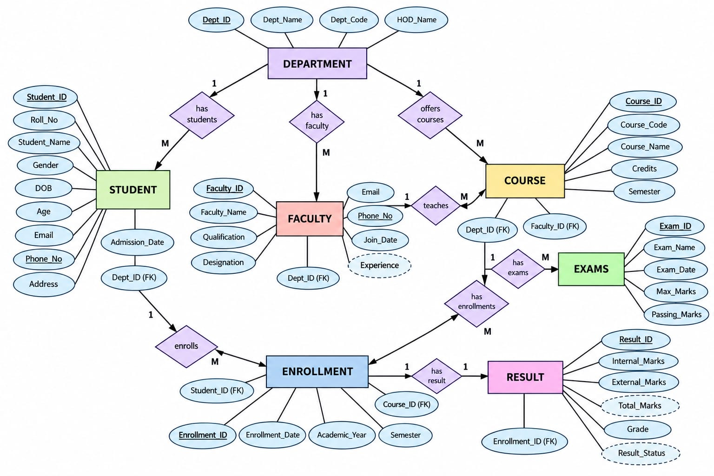
ER diagram

Slide 11
Relational Schema
Relation / Table | Attributes
DEPARTMENT | DEPT_ID (PK), DEPT_NAME, DEPT_CODE, HOD_NAME
STUDENT | STUDENT_ID (PK), ROLL_NO, STUDENT_NAME, GENDER, DOB, EMAIL, PHONE_NO, ADDRESS, ADMISSION_DATE, DEPT_ID (FK)
FACULTY | FACULTY_ID (PK), FACULTY_NAME, QUALIFICATION, DESIGNATION, EMAIL, PHONE_NO, JOIN_DATE, EXPERIENCE, DEPT_ID (FK)
COURSE | COURSE_ID (PK), COURSE_CODE, COURSE_NAME, CREDITS, SEMESTER, DEPT_ID (FK), FACULTY_ID (FK)
ENROLLMENT | ENROLLMENT_ID (PK), STUDENT_ID (FK), COURSE_ID (FK), ENROLLMENT_DATE, ACADEMIC_YEAR, SEMESTER
EXAMS | EXAM_ID (PK), EXAM_NAME, EXAM_DATE, MAX_MARKS, PASSING_MARKS
RESULT | RESULT_ID (PK), ENROLLMENT_ID (FK), EXAM_ID (FK), INTERNAL_MARKS, EXTERNAL_MARKS, TOTAL_MARKS, GRADE, RESULT_STATUS

Slide 12
Relationship & Cardinality
No. | Entity 1 | Relationship | Entity 2 | Cardinality
1 | DEPARTMENT | has | STUDENT | 1 : M
2 | DEPARTMENT | has | FACULTY | 1 : M
3 | DEPARTMENT | offers | COURSE | 1 : M
4 | FACULTY | teaches | COURSE | 1 : M
5 | STUDENT | enrolls in | COURSE | M : N
6 | STUDENT | has | ENROLLMENT | 1 : M
7 | COURSE | has | ENROLLMENT | 1 : M
8 | COURSE | conducts | EXAMS | 1 : M
9 | ENROLLMENT | generates | RESULT | 1 : 1
10 | EXAMS | has | RESULT | 1 : M

Slide 13
Conclusion
The University Academic Management System provides an efficient way to manage academic data using DBMS.
It helps organize student, faculty, course, examination, marks, and attendance information.
The system reduces manual work, data duplication, and errors.
It provides quick, secure, and accurate access to academic records.
It also helps the university maintain accurate records and make better academic decisions.
Overall, the system makes university academic management simple, organized, and efficient.

Slide 14
Thank You

Slide 15
University Academic Management
Review-2
Batch – 13
S. Keerthi - 26B21CS076
T. Lakshmi Anvitha - 26B21CS079
G. Bhagya Deepthi - 25B11CS268
P. Roshitha – 25B11CS749

Slide 16
Complete ER diagram

Slide 17
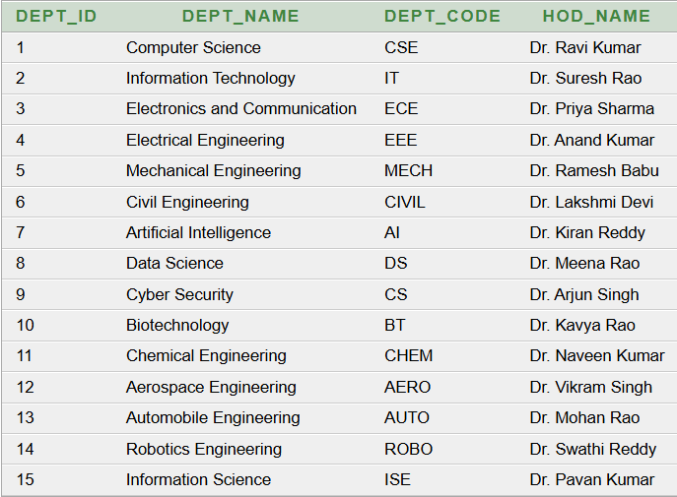
SQL Table Creation
Department Table Creation:
CREATE TABLE DEPARTMENT
(
DEPT_ID NUMBER(5) PRIMARY KEY,
DEPT_NAME VARCHAR2(50) NOT NULL,
DEPT_CODE VARCHAR2(10) UNIQUE NOT NULL,
HOD_NAME VARCHAR2(50) NOT NULL
);
Output:
After inserting 15 records.
SQL> SELECT *FROM DEPARTMENT;

Slide 18
Student Table Creation:
CREATE TABLE STUDENT
(
STUDENT_ID NUMBER(5) PRIMARY KEY,
ROLL_NO VARCHAR2(20) UNIQUE NOT NULL,
STUDENT_NAME VARCHAR2(50) NOT NULL,
GENDER VARCHAR2(10) CHECK (GENDER IN ('Male', 'Female', 'Other')),
DOB DATE NOT NULL,
AGE NUMBER(3),
EMAIL VARCHAR2(100) UNIQUE,
PHONE_NO VARCHAR2(15) UNIQUE,
ADDRESS VARCHAR2(100),
ADMISSION_DATE DATE NOT NULL,
DEPT_ID NUMBER(5) NOT NULL,
CONSTRAINT FK_STUDENT_DEPT
FOREIGN KEY (DEPT_ID)
REFERENCES DEPARTMENT(DEPT_ID),
CONSTRAINT CHK_STUDENT_AGE
CHECK (AGE >= 16 AND AGE <= 60));

Slide 19
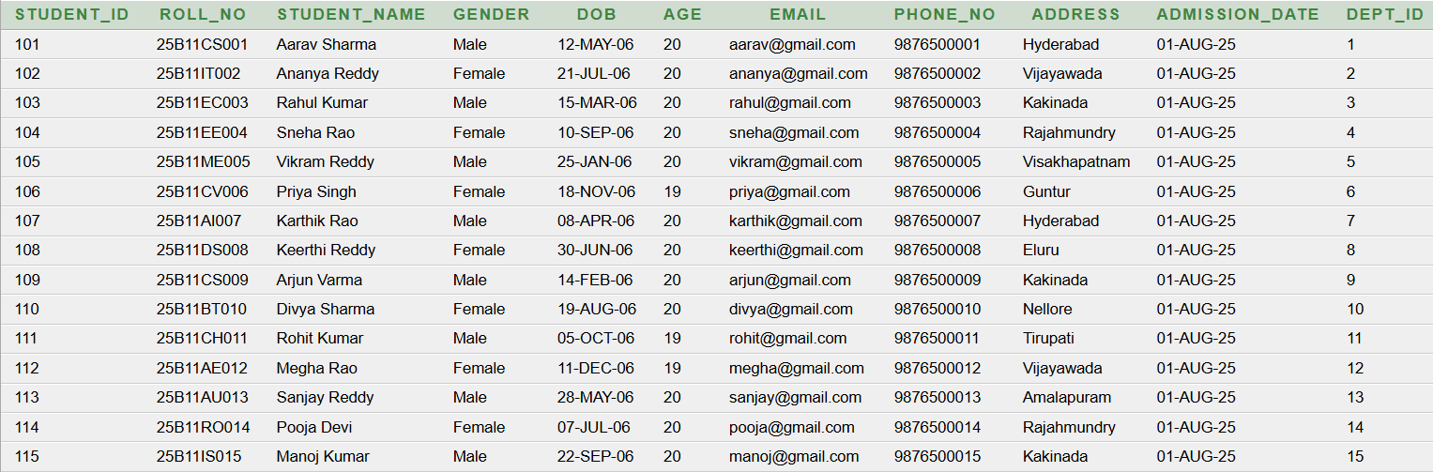
Output:
After inserting 15 records.
SQL> SELECT *FROM STUDENT;

Slide 20
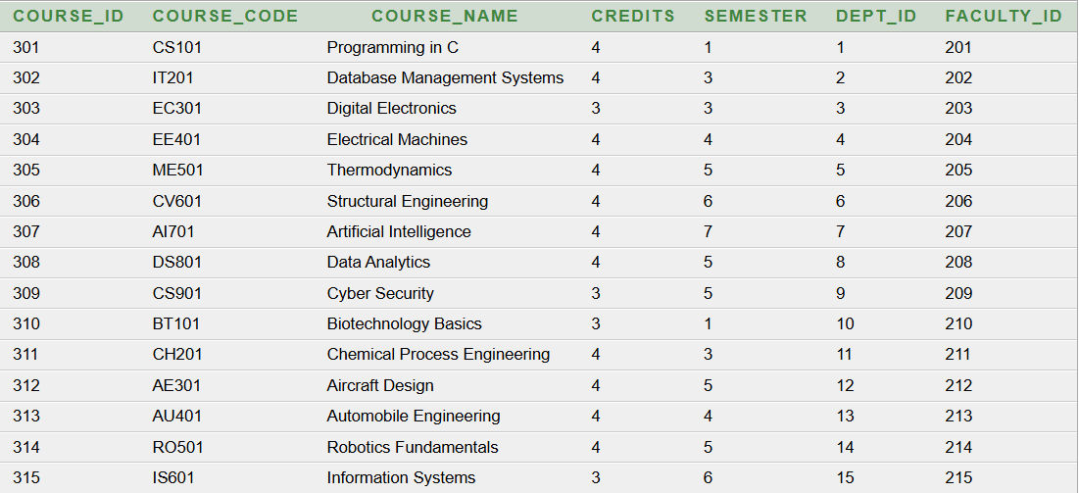
Output:
After inserting 15 records.
SQL> SELECT *FROM COURSE;
Course Table Creation:
CREATE TABLE COURSE
(
COURSE_ID NUMBER(5) PRIMARY KEY,
COURSE_CODE VARCHAR2(15) UNIQUE NOT NULL,
COURSE_NAME VARCHAR2(100) NOT NULL,
CREDITS NUMBER(2) CHECK (CREDITS BETWEEN 1 AND 10),
SEMESTER NUMBER(2) CHECK (SEMESTER BETWEEN 1 AND 8),
DEPT_ID NUMBER(5) NOT NULL,
FACULTY_ID NUMBER(5) NOT NULL,
CONSTRAINT FK_COURSE_DEPT
FOREIGN KEY (DEPT_ID)
REFERENCES DEPARTMENT(DEPT_ID),
CONSTRAINT FK_COURSE_FACULTY
FOREIGN KEY (FACULTY_ID)
REFERENCES FACULTY(FACULTY_ID));

Slide 21
Keys & Constraints
Primary Keys (PK): Uniquely identify each record.
Examples: STUDENT_ID, FACULTY_ID, COURSE_ID
Foreign Keys (FK): Connect related tables.
Examples: DEPT_ID, STUDENT_ID, COURSE_ID, FACULTY_ID
Constraints Used:
PRIMARY KEY – Unique and not NULL
FOREIGN KEY – Maintains table relationships
NOT NULL – Value is mandatory
UNIQUE – Prevents duplicate values
CHECK – Restricts invalid values

Slide 22
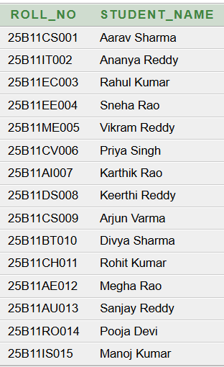
Basic queries & Outputs
1.Display student names and roll numbers.
SQL> SELECT ROLL_NO, STUDENT_NAME FROM STUDENT;
Output:

Slide 23


2.Display students from the Computer Science department.
SQL>SELECT STUDENT_NAME, ROLL_NO, DEPT_ID
FROM STUDENT
WHERE DEPT_ID = 1;
Output:
3.Display different genders available in the student table.
SQL>SELECT DISTINCT GENDERFROM STUDENT;
Output:

Slide 24

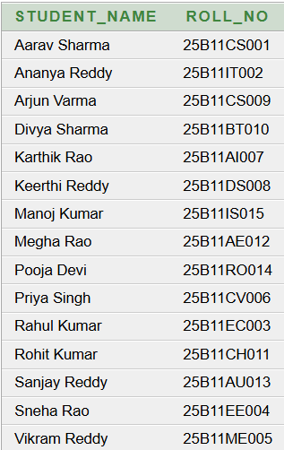
4. Find the total number of students.
SQL>SELECT COUNT(*) AS TOTAL_STUDENTS FROM STUDENT;
Output:
5. Display students in alphabetical order.
SQL>SELECT STUDENT_NAME, ROLL_NO FROM STUDENT
ORDER BY STUDENT_NAME;
Output:

Slide 25
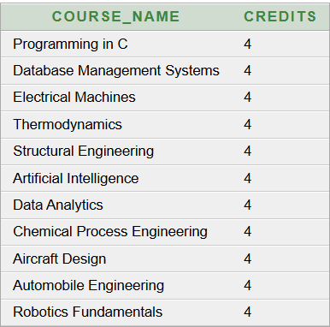
6. Display courses with 4 credits.
SQL>SELECT COURSE_NAME, CREDITS FROM COURSE
WHERE CREDITS = 4;
Output:

Slide 26
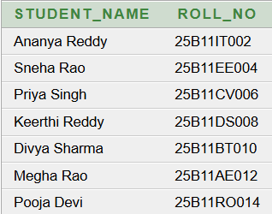
7. Display female students with name and roll no.
SQL>SELECT STUDENT_NAME, ROLL_NO FROM STUDENT
WHERE GENDER = 'Female’;
Output:

Slide 27
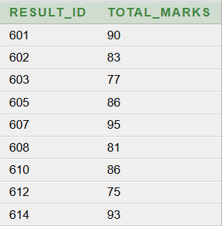
8 Advanced queries & Outputs
Subquery:
Students who scored above the average marks.
SQL> SELECT RESULT_ID, TOTAL_MARKS
FROM RESULT
WHERE TOTAL_MARKS > (SELECT AVG(TOTAL_MARKS)
FROM RESULT);
Output:

Slide 28
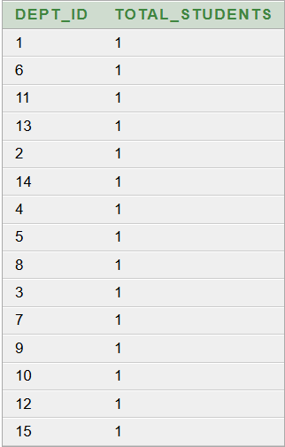
2. GROUP BY + COUNT:
The number of students in each department.
SQL> SELECT DEPT_ID, COUNT(*) AS TOTAL_STUDENTS
FROM STUDENT
GROUP BY DEPT_ID;
Output:

Slide 29
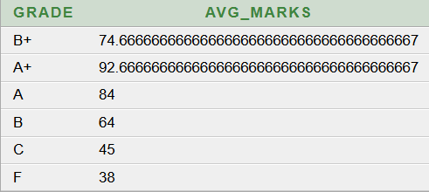
3. GROUP BY + AVG:
The average marks for each grade.
SQL> SELECT GRADE, AVG(TOTAL_MARKS) AS AVG_MARKS
FROM RESULT
GROUP BY GRADE;
Output:

Slide 30
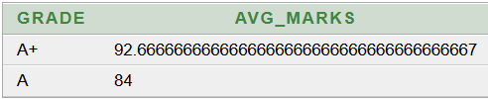
4. HAVING:
Display grades whose average marks are greater than 75.
SQL> SELECT GRADE, AVG(TOTAL_MARKS) AS AVG_MARKS
FROM RESULT
GROUP BY GRADE
HAVING AVG(TOTAL_MARKS) > 75;
Output:

Slide 31
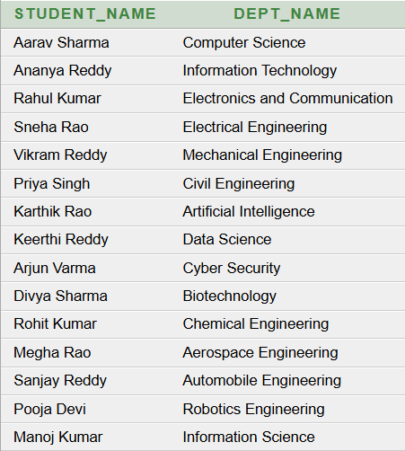
5. JOIN – Student + Department:
Display student names along with their department names.
SQL> SELECT S.STUDENT_NAME, D.DEPT_NAME
FROM STUDENT S
JOIN DEPARTMENT D
ON S.DEPT_ID = D.DEPT_ID;
Output:

Slide 32
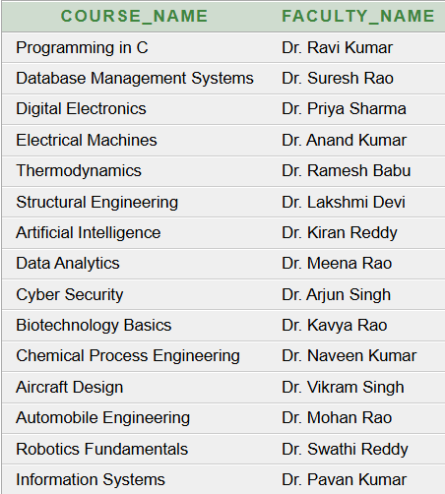
6. JOIN – Course + Faculty:
The course name along with the faculty name who teaches the course.
SQL> SELECT C.COURSE_NAME, F.FACULTY_NAME
FROM COURSE C
JOIN FACULTY F
ON C.FACULTY_ID = F.FACULTY_ID;
Output:

Slide 33
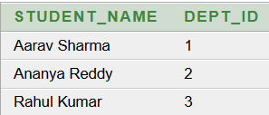
7. IN Operator:
Display students belonging to departments 1, 2 and 3.
SQL> SELECT STUDENT_NAME, DEPT_ID
FROM STUDENT
WHERE DEPT_ID IN (1, 2, 3);
Output:

Slide 34
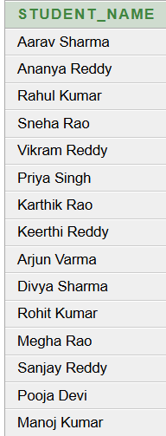
8. EXISTS: Output:
Display students who have an enrollment record.
SQL> SELECT STUDENT_NAME
FROM STUDENT S
WHERE EXISTS (
SELECT 1
FROM ENROLLMENT E
WHERE E.STUDENT_ID = S.STUDENT_ID );

Slide 35
Normalization up to 3NF
1NF – First Normal Form:
Table: STUDENT_COURSE
Student_ID | Student_Name | Dept_ID | Dept_Name | Course_ID | Course_Name
101 | Aarav Sharma | 1 | Computer Science | 301 | Programming in C
102 | Ananya Reddy | 2 | Information Technology | 302 | DBMS
103 | Rahul Kumar | 3 | Electronics | 303 | Digital Electronics
1NF:
All attributes contain atomic values.
No repeating groups are present.
Each record is uniquely identifiable.
Result:
The values are atomic and there are no repeating groups, so the table satisfies 1NF.

Slide 36
2NF – Second Normal Form
Rule
The table must already be in 1NF.
Partial dependency must be removed.
Non-key attributes must depend on the complete primary key.
In the 1NF table, the primary key is:
(Student_ID, Course_ID)
But:
Student_Name depends only on Student_ID.
Course_Name depends only on Course_ID.
Therefore, we decompose the table.
Table 1: STUDENT
Student_ID (PK) | Student_Name | Dept_ID | Dept_Name
101 | Aarav Sharma | 1 | Computer Science
102 | Ananya Reddy | 2 | Information Technology
103 | Rahul Kumar | 3 | Electronics and Communication

Slide 37
Table 2: COURSE
Course_ID (PK) | Course_Name | Dept_ID
301 | Programming in C | 1
302 | DBMS | 2
303 | Digital Electronics | 3
Table 3: ENROLLMENT
Enrollment_ID (PK) | Student_ID (FK) | Course_ID (FK)
401 | 101 | 301
402 | 102 | 302
403 | 103 | 303
Result:
Partial dependencies are removed, and the database is now in 2NF.

Slide 38
3NF – Third Normal Form
Rule
The table must already be in 2NF.
Transitive dependency must be removed.
Non-key attributes should depend only on the primary key.
In the 2NF STUDENT table:
Student_ID → Dept_ID → Dept_Name
So, Dept_Name indirectly depends on Student_ID through Dept_ID.
Therefore, we separate the department information.
Table 1: STUDENT
Student_ID (PK) | Student_Name | Dept_ID (FK)
101 | Aarav Sharma | 1
102 | Ananya Reddy | 2
103 | Rahul Kumar | 3

Slide 39
Table 2: DEPARTMENT
Dept_ID (PK) | Dept_Name | Dept_Code
1 | Computer Science | CSE
2 | Information Technology | IT
3 | Electronics and Communication | ECE
Table 3: COURSE
Course_ID (PK) | Course_Name | Dept_ID (FK)
301 | Programming in C | 1
302 | DBMS | 2
303 | Digital Electronics | 3

Slide 40
Table 4: ENROLLMENT
Enrollment_ID (PK) | Student_ID (FK) | Course_ID (FK)
401 | 101 | 301
402 | 102 | 302
403 | 103 | 303
Result:
The transitive dependency is removed by creating a separate DEPARTMENT table. The database is now in 3NF.

Slide 41
Conclusion
The University Academic Management System was successfully designed using DBMS concepts.
The system manages students, departments, faculty, courses, enrollment, examinations, and results efficiently.
Primary keys, foreign keys, and constraints are used to maintain data integrity and consistency.
SQL queries were implemented to retrieve and analyze academic information.
The database was normalized up to 3NF to reduce redundancy and avoid data anomalies.
Overall, the system provides a structured, reliable, and efficient way to manage university academic data.

Slide 42
Thank You

